Slide 1
Systolic Processor Array using FPGA
Guide:- Team Members:
Mr. Rashid P.E 20. Deepak J Puthukkaden
31. Giridhar A K
32. Govindh B
53. Rohit Sreekumar
59. Shine Ali

Slide 2
OBJECTIVE
- To study on Systolic Architecture.
- To design and Implement an n-bit Processor
using Systolic Array Architecture on FPGA
prototyping platform.

Slide 3
OVERVIEW
Systolic Processor architecture incorporates extended parallelism and efficient processing thereby increasing the system performance when compared to existing general purpose processors. The Systolic array processor is implemented on a Xilinx Spartan 3E FPGA.

Slide 4
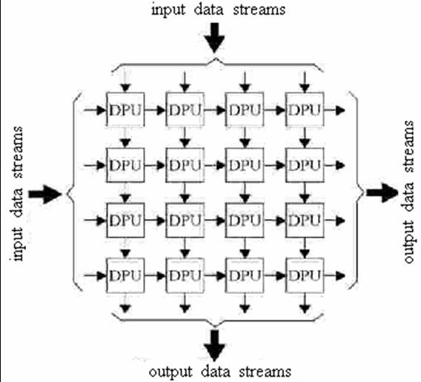
Block Diagram
Input Data
FPGA with multiple DPU’s
Processed Data

Slide 5
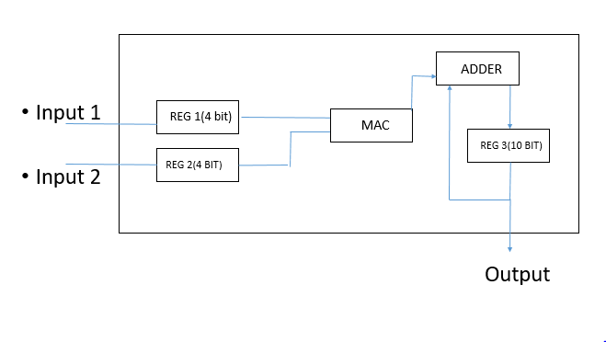
DPU Architecture

Slide 6
Tasks Completed
Single DPU designed, tested and verified
Designed 3*3 systolic architecture
Successfully Simulated 3*3 systolic architecture

Slide 7
Tasks pending
FPGA implementation
Report preparation

Slide 8
FUTURE SCOPE
A system of re-configurable templates to run various applications can be implemented. A system of PE array architecture with a flexible data path can be used to develop a universal platform of reconfigure hardware along with sufficient memory and registers and ports for input data and output data.

Slide 9
REFERENCES
[1] Mosleh, M. ;Setayeshi, S. ;Mehdi Lotfinejad, M. ;Mirshekari, A. , ”FPGA implementation of a orthogonal systolic array for speech recognition”, Computer and Automation Engineering (ICCAE), 2010 The 2nd International Conference on (Volume:3 ), 26-28 Feb. 2010, pages 75-78
[2] Ong, K, S, H, ;Fahmy, S.A. ;Keck-Voon Ling, “A scalable and compact systolic architecture for linear solvers”, Application-specific Systems, Architectures and Processors (ASAP), 2014 IEEE 25th International Conference on,18-20 June 2014, pages 186 – 187
[3] Ibrahim, A. ;Gebali, F. ;Al-Somani, T.F, “Systolic Array Architectures for Normal Basis Type II Multiplier”,IEEE Transactions on Very Large Scale Integration (VLSI) Systems, Oct 2015, pages 2090-2102

Slide 10
THANK YOU

